Slide 1
Text-Based Real-Time Emotion Analysis On Cloud Service
Milestone02：Design
Team Social Network Observer
ZHANG ZERU
t0925950@u.nus.edu

Slide 2
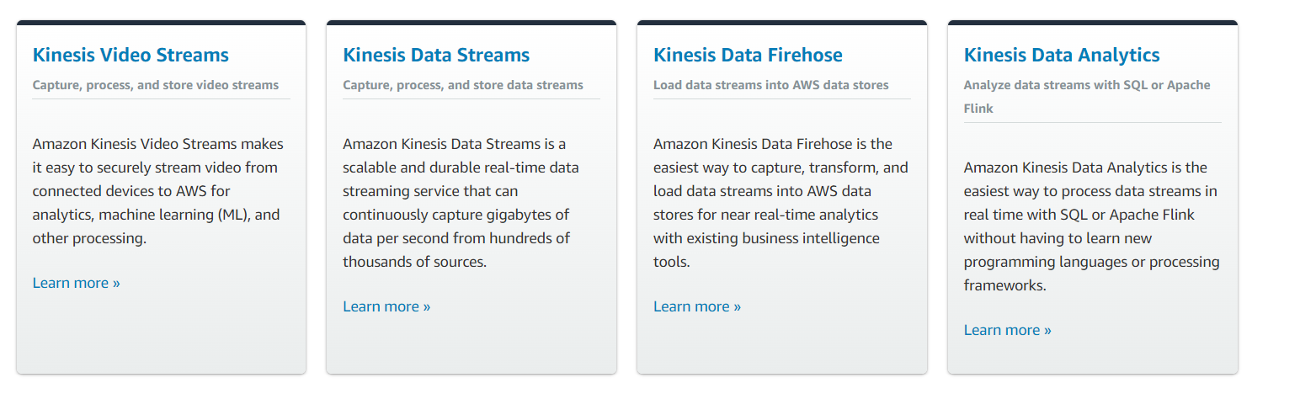
Key Service Part: Kinesis
02
Amazon Kinesis is a streaming data collection and processing service. It will enable us to analyze real-time data.

Slide 3
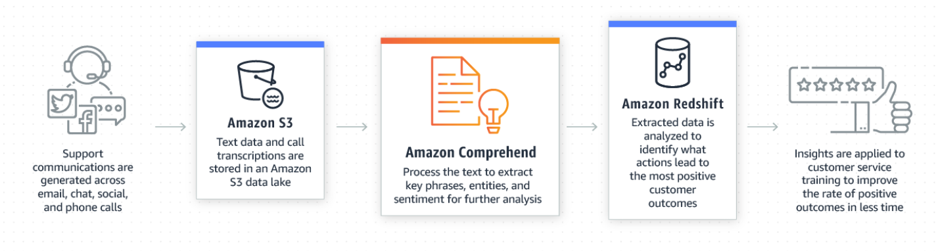
Key Service Part: Amazon Comprehend
02
Amazon Comprehend is a natural language processing service
that utilizes deep learning techniques to implement text sentiment, named entities, analysis of key phrases, and topic classification of articles.

Slide 4
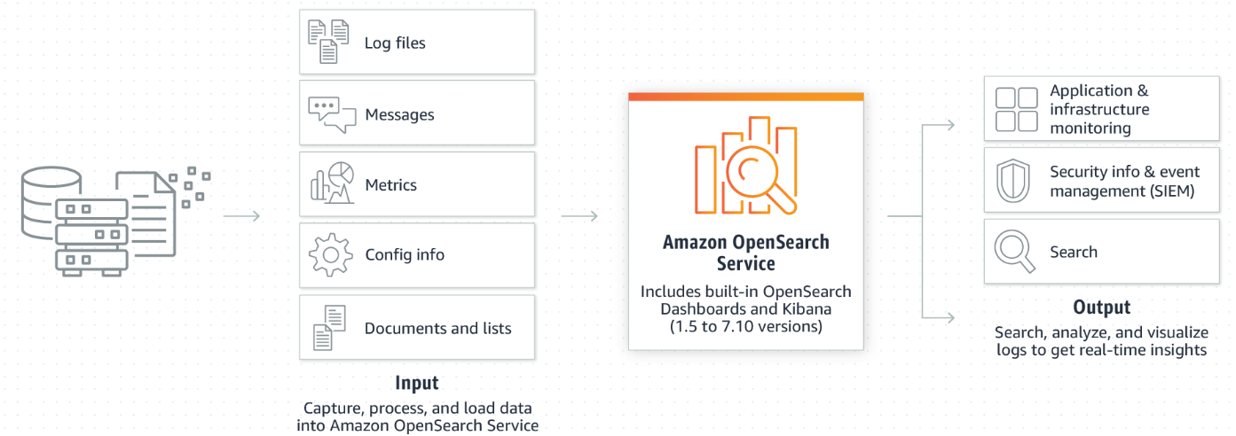
Key Service Part: OpenSearch
02
Amazon OpenSearch Service is a managed Service that makes it easy to deploy, operate, and extend OpenSearch clusters in the AWS cloud.

Slide 5
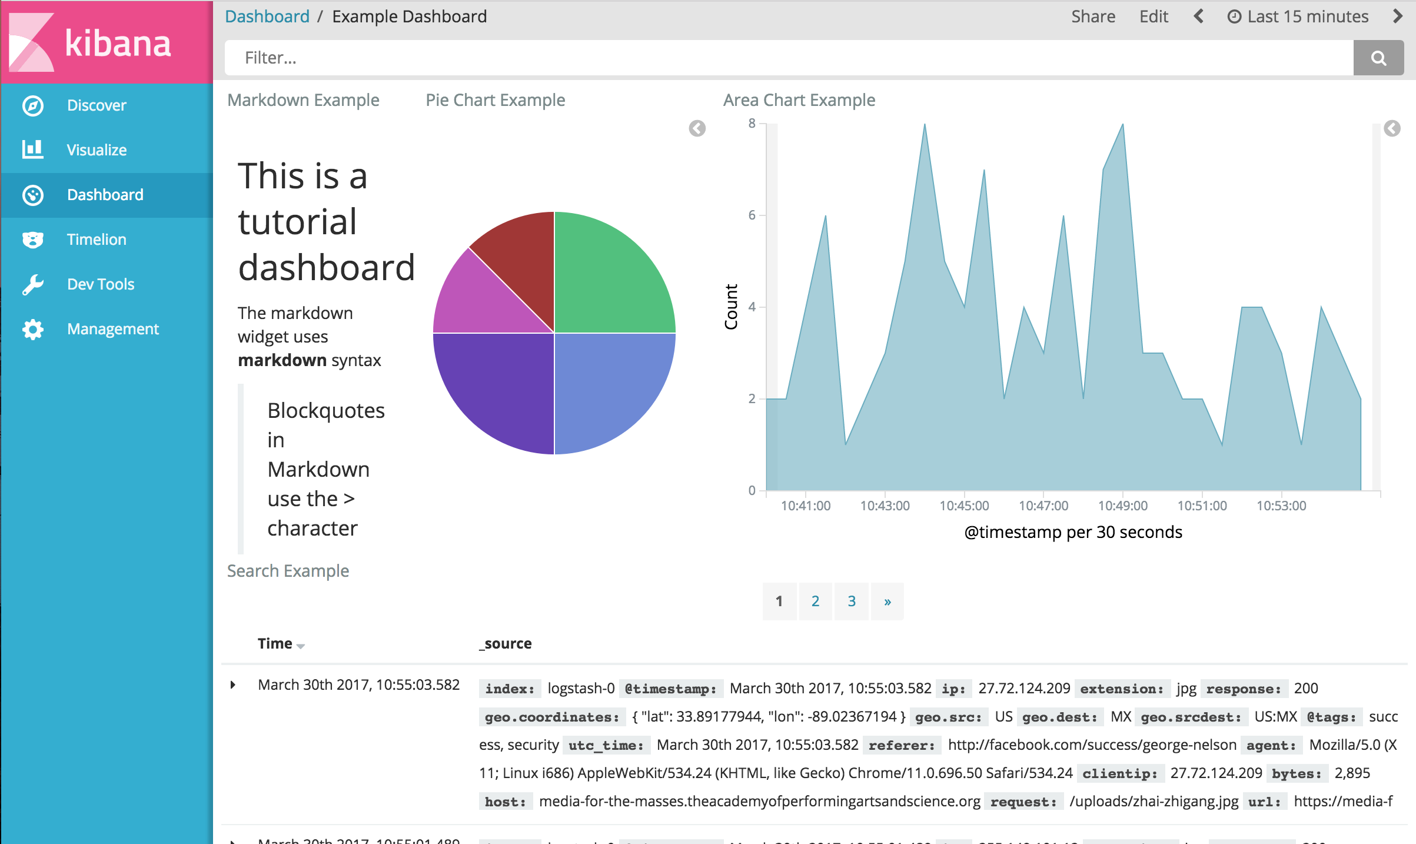
Key Service Part: Kibana
02
An open source analysis visualization tool for OpenSearch that interacts with data stored in the OpenSearch cluster.

Slide 6
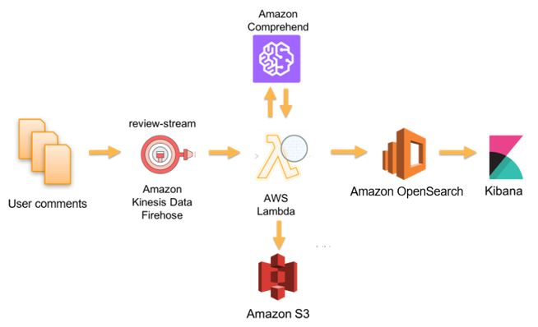
Design Diagram
02

Slide 7
THANK YOU

